Slide 1
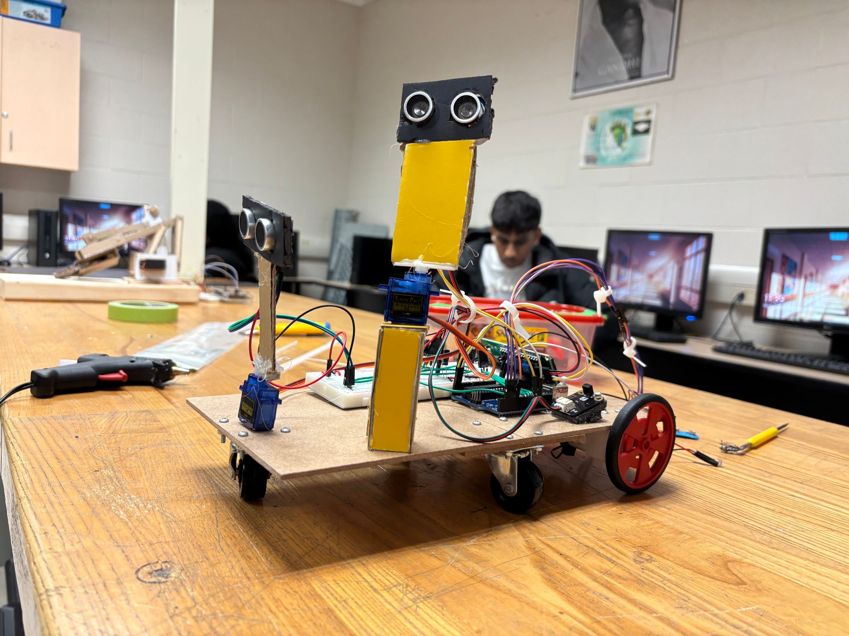

Mr. Beep-A-Lot
Computer Engineering Final Project
Syed Shayan Mazahir

Slide 2
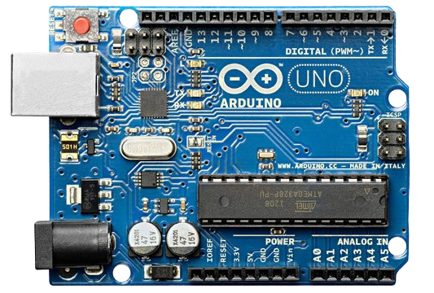
Material List

Slide 3
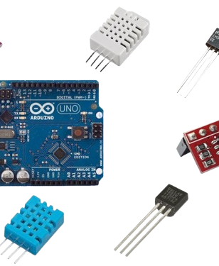
Ultrasonic sensor x 2
Arduino Board x 1 (UNO)
LCD Screen 16x2 x 1
Breadboard x 1
Motors x 2
Wheels x 2
360 Rotation wheel x 3
L298N Motor Driver x 1
Jumper Wires
Wires
Servo Motors x 2
Capacitors x 2 (100v and 50v)
Resistor x 2 (100 ohm)
PPE Battery x 2 (9v)
PPE Battery Connectors x 2
IR Remote x 1
IR Receiver x 1
Arduino Cable x 1
Cable Extender dongle x 1
Screws x 12
Hot Glue Sticks x 5 maybe 7 (whole class was using it)

Slide 4

Ultrasonic sensor x 2 ($0.20 - $0.60 AliBaba)
Arduino Board x 1 (UNO) ($0.19 - $3.99 AliBaba)
LCD Screen 16x2 x 1 ($0.80 - $1.20 AliBaba)
Breadboard x 1 ($0.40 - $0.45 AliBaba)
Motors x 2 ($0.13 - $0.40 AliBaba)
Wheels x 2 ($0.13- $0.40 AliBaba)
360 Rotation wheel x 3 ($0.35 - $1.85 AliBaba)
L298N Motor Driver x 1 ($0.12 - $3.76 AliBaba)
Jumper Wires ($0.05 - $1.50 AliBaba)
Wires (websites says per feet/inch/cm/m, but avg is: $0.35)
Servo Motors x 2 ($0.59 - $0.70 AliBaba)
Capacitors x 2 (100v and 50v) (wasn’t able to find any capacitors)
Resistor x 2 (100 ohm) (Pack: $0.01 AliBaba)
PPE Battery x 2 (9v) ($0.01 - $0.60 AliBaba)
PPE Battery Connectors x 2 (Wasn’t able to find any SURPRISINGLY)
IR Remote x 1 ($0.60 ELECROW)
IR Receiver x 1 ($3.90 DFRobot)
Arduino Cable x 1 ($1.90 DFRobot)
Cable Extender dongle x 1 ($8.40 Amazon)
Screws x 12 (Wasn’t able to find the exact one; again SURPRISINGLY)
Hot Glue Sticks x 5 maybe 7 (whole class was using it) ($1 Local Dolarama)

Slide 5
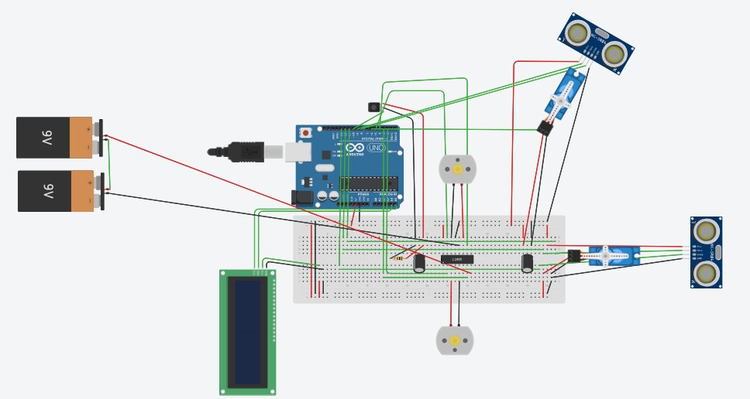

Schematic

Slide 6
Project Timeline
18 Nov - 24 Nov
24 Nov - 30 Nov
30 Nov - 8 Dec
8 Dec - 16 Dec
Setting up
Getting Ready
Start Making
Debugging
Cut the base
Start hunting for parts
Start modifying the V1 of the plan
Start testing out the boards (UNO, Mega, GeekCreit)
Decide on how to replicate the shields
Start wiring the sensors, breadboard, Arduino
Set up the position for each of the components
Fix noise transmission
Fix power surge
Fix motors
Finalize drivers
Finalize power supply
Join things together

Slide 7
Step-by-Step building

Slide 8
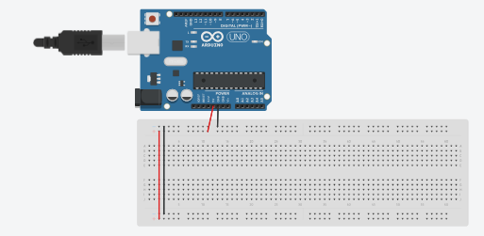
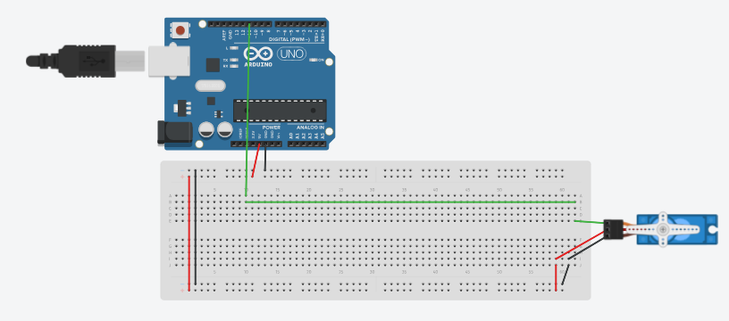

Slide 9
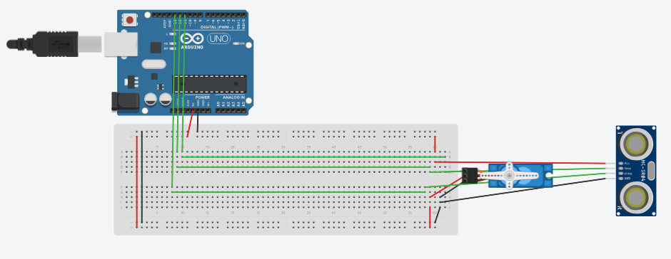
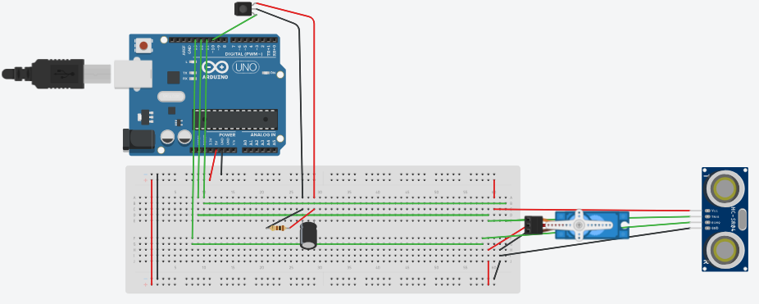

Slide 10
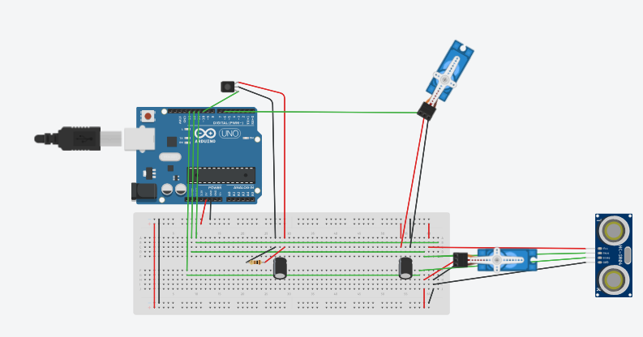
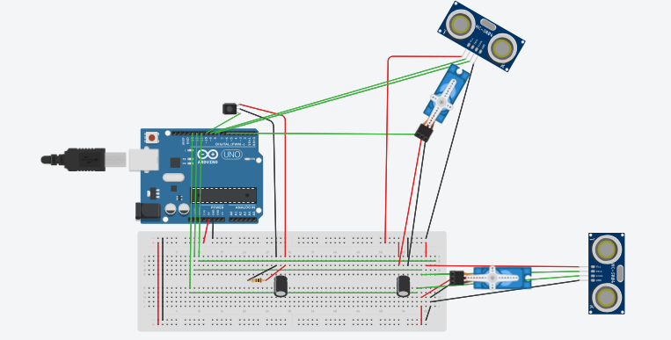

Slide 11
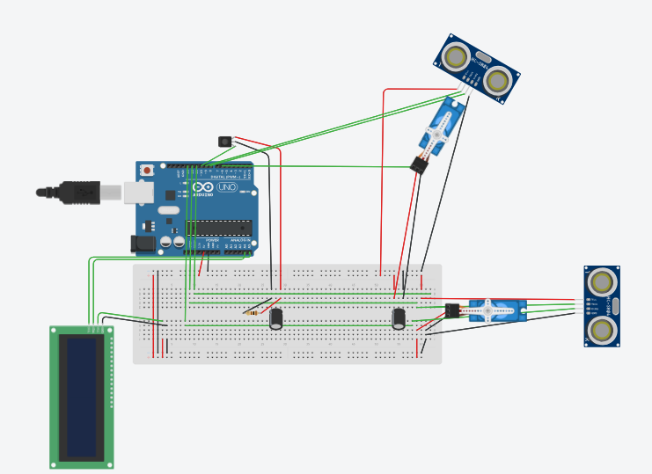

Slide 12
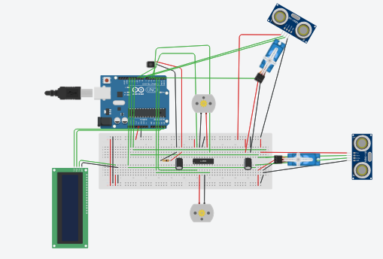

Slide 14

Conclusion – Reflection. What is the most valuable lesson you learned from this experience? If you could, would you build this again or choose another project. Why or why not?
The docs are no help
There are 2 different kind or motors
Parallel and Series Circuits in action
You can make anything; literally anything
Wiring GND to VCC and VCC to GND will fry your circuit
Having different components is fun until you get a power surge
Capacitors are life savers
How to prevent “noise”
I would for sure build this project again; and maybe try to make the project as near to the real design I had in mind.

